Slide 1
Dimensionality Reduction
Dr. Nassim Sohaee

Slide 2

Example: MNIST
28 Pixels

Slide 3
Pros and Cons
Pros | Cons
speed up training | system perform slightly worse
data visualization | lose some information

Slide 4
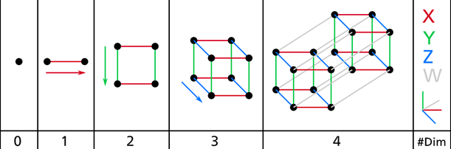
The Curse of Dimensionality

Slide 5
Unit square/cube/hypercube
0.001

Slide 6
Distance of two points
2 – dimension | 0.52
3 – dimension | 0.66
1,000,000 – dimension | 408.25

Slide 7
Distance of two instances
Sparse training sets
Less reliable predictions in higher dimension
overfitting

Slide 8
Approaches in Dimensionality Reduction
Projection
Manifold Learning

Slide 9
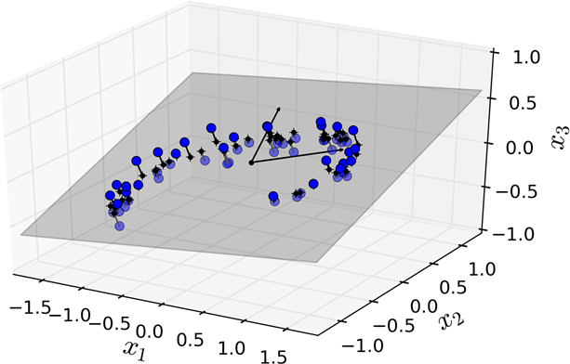
Projection

Slide 10
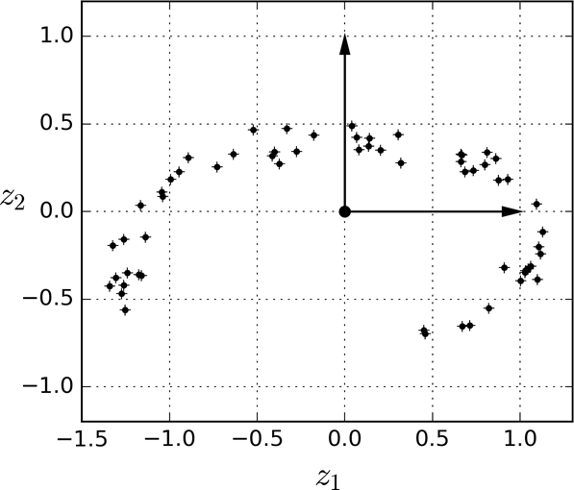
Projection

Slide 11
PCA
Principal Component Analysis (PCA) is by far the most popular dimensionality reduction algorithm.
First it identifies the hyperplane that lies closest to the data, and then it projects the data onto it.

Slide 12
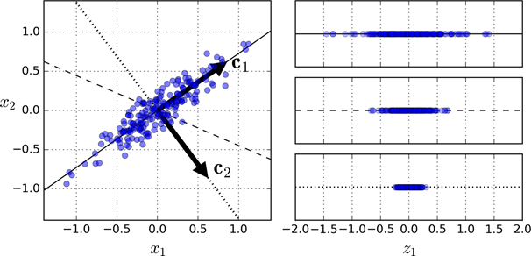
Preserving variance

Slide 14
Principal components
PCA identifies the axis that accounts for the largest amount of variance in the training set.
The unit vector that defines the i^{th} axis is called the i^{th} principal component (PC).
The direction of the principal components is not stable.

Slide 15

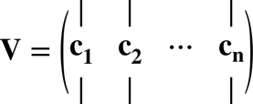
The eigenvectors are called principal axes or principal directions of the data.

Slide 16
Projecting down to d dimensions

Slide 17
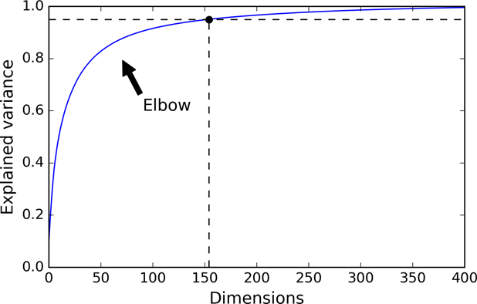
Explained Variance Ratio

Slide 18
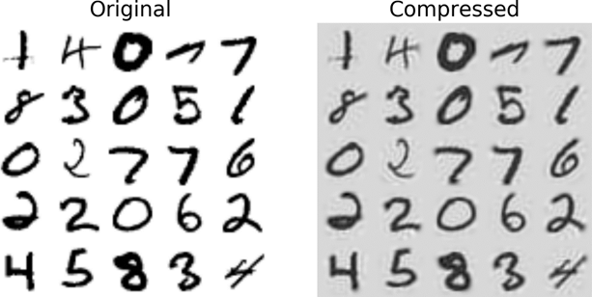
PCA for compression

Slide 19
PCA for compression
Reconstruction Error

Slide 20
Incremental PCA
Problem: PCA requires the whole training set to fit in memory in order for the SVD algorithm to run.
Solution: Incremental PCA
Running time: O(m × n²) + O(n³)

Slide 21
Stochastic PCA
Finds an approximation of the first d principal components.
Running time: O(m × d²) + O(d³)

Slide 22
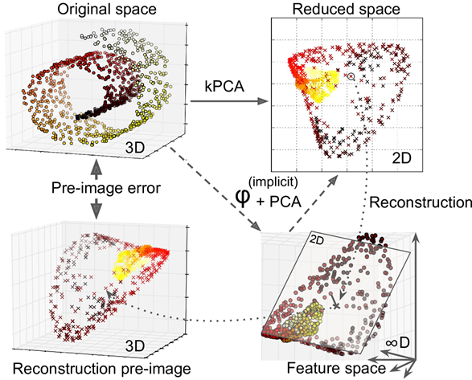
Kernel PCA

Slide 23
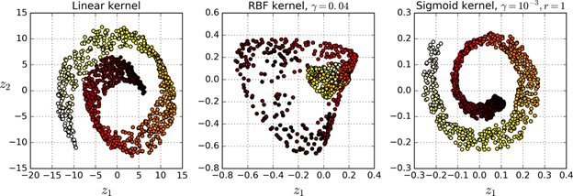
Kernel PCA

Slide 24

Reconstruction
$X_{m×n}$ : Training set – Centered
$m$: Number of instances
$n$ : Number of features

Slide 25
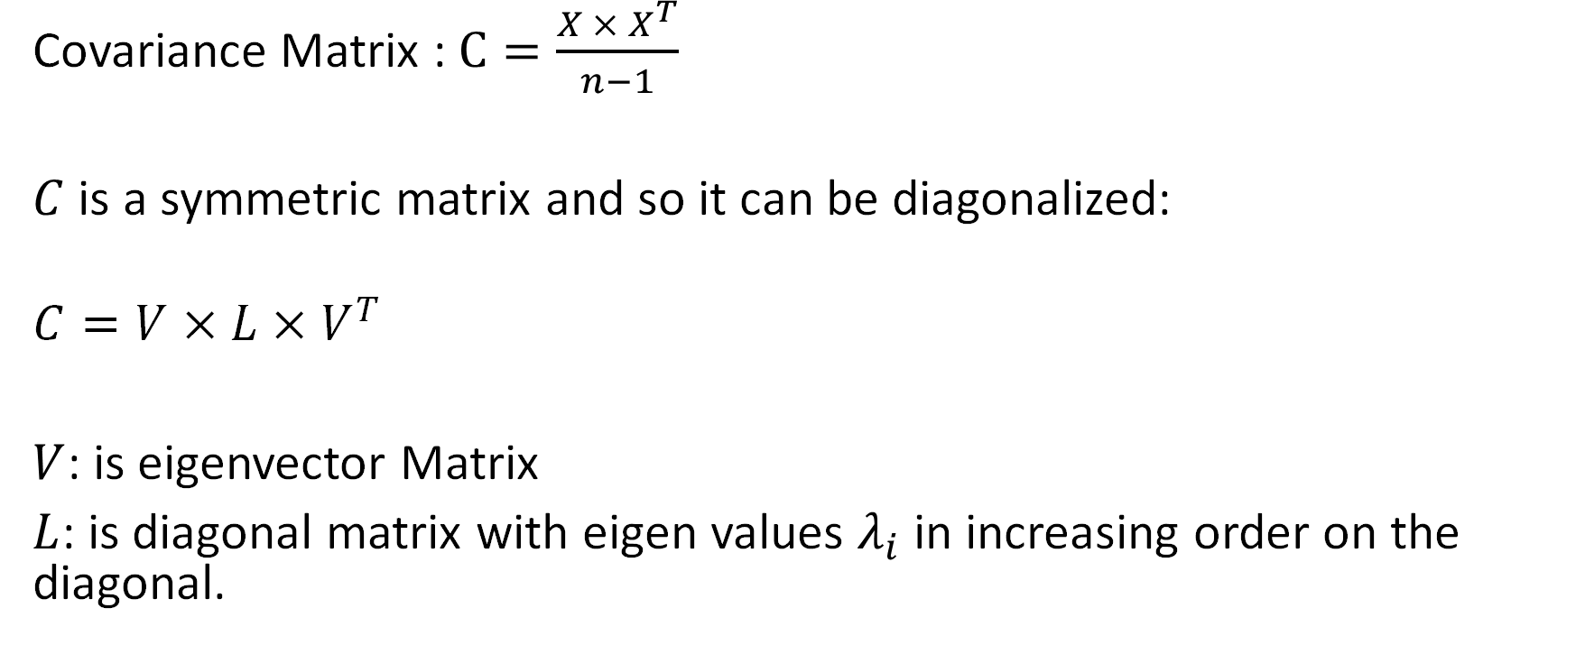
Reconstruction
Covariance Matrix : $C=\frac{{X × X}^{T}}{n−1}$
$C$ is a symmetric matrix and so it can be diagonalized:
$$C=V×L×V^{T}$$
$V$: is eigenvector Matrix
$L$: is diagonal matrix with eigen values $λ_{i}$ in increasing order on the diagonal.

Slide 26

Reconstruction
$$L=\left[\begin{matrix}λ_{1} & ⋯ & 0 \\ ⋮ & ⋱ & ⋮ \\ 0 & ⋯ & λ_{n}\end{matrix}\right]$$
$V$ is the principal axes.
Projecting training set $X$ means finding $X×V$

Slide 27
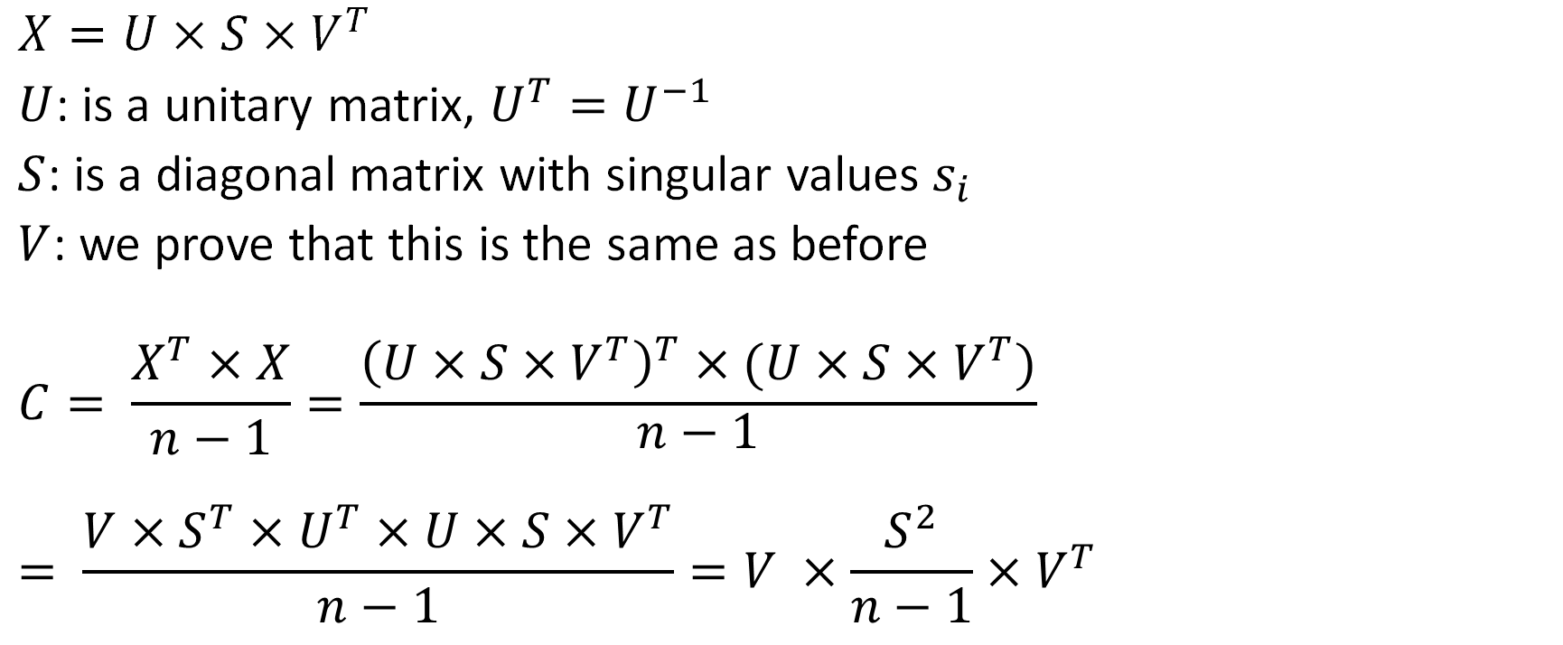
Reconstruction
$$X=U×S×V^{T}$$
$U$: is a unitary matrix, $U^{T}=U^{−1}$
$S$: is a diagonal matrix with singular values $s_{i}$
$V$: we prove that this is the same as before
$$C= \frac{X^{T}×X}{n−1}=\frac{{\left(U×S×V^{T}\right)}^{T}×(U×S×V^{T})}{\begin{aligned}n−1 \\ \end{aligned}}= \frac{V×S^{T}×U^{T}×U×S×V^{T}}{n−1}=V ×\frac{S^{2}}{n−1}{×V}^{T}$$

Slide 28

Reconstruction
$$X=U×S×V^{T}$$
$$=\left[\begin{matrix}| & | & | \\ U_{1} & … & U_{k} \\ | & | & |\end{matrix} \begin{matrix}| & | & | \\ U_{k+1} & … & U_{n} \\ | & | & |\end{matrix}\right]×\left[\begin{matrix}\left[\begin{matrix}s_{1} & … & 0 \\ ⋮ & ⋱ & ⋮ \\ 0 & … & s_{k}\end{matrix}\right] & … & 0 \\ ⋮ & ⋱ & ⋮ \\ 0 & … & s_{n}\end{matrix}\right]×{\left[\begin{matrix}V_{k×k} & … \\ … & …\end{matrix}\right]}^{T}$$

Slide 29

Reconstruction
$$X_{k}=U_{k}×S_{k}×V_{k}^{T}$$
$$m×k m×k k×k k×k$$

Slide 30
Approaches in Dimensionality Reduction
Projection
Manifold Learning

Slide 31
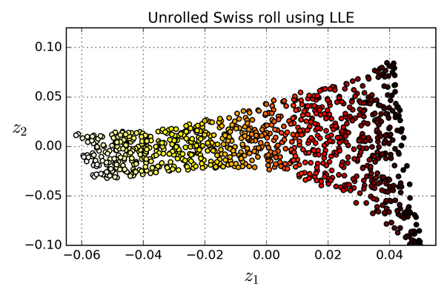
LLE
Locally Linear Embedding

Slide 32
How LLE works:

Slide 33
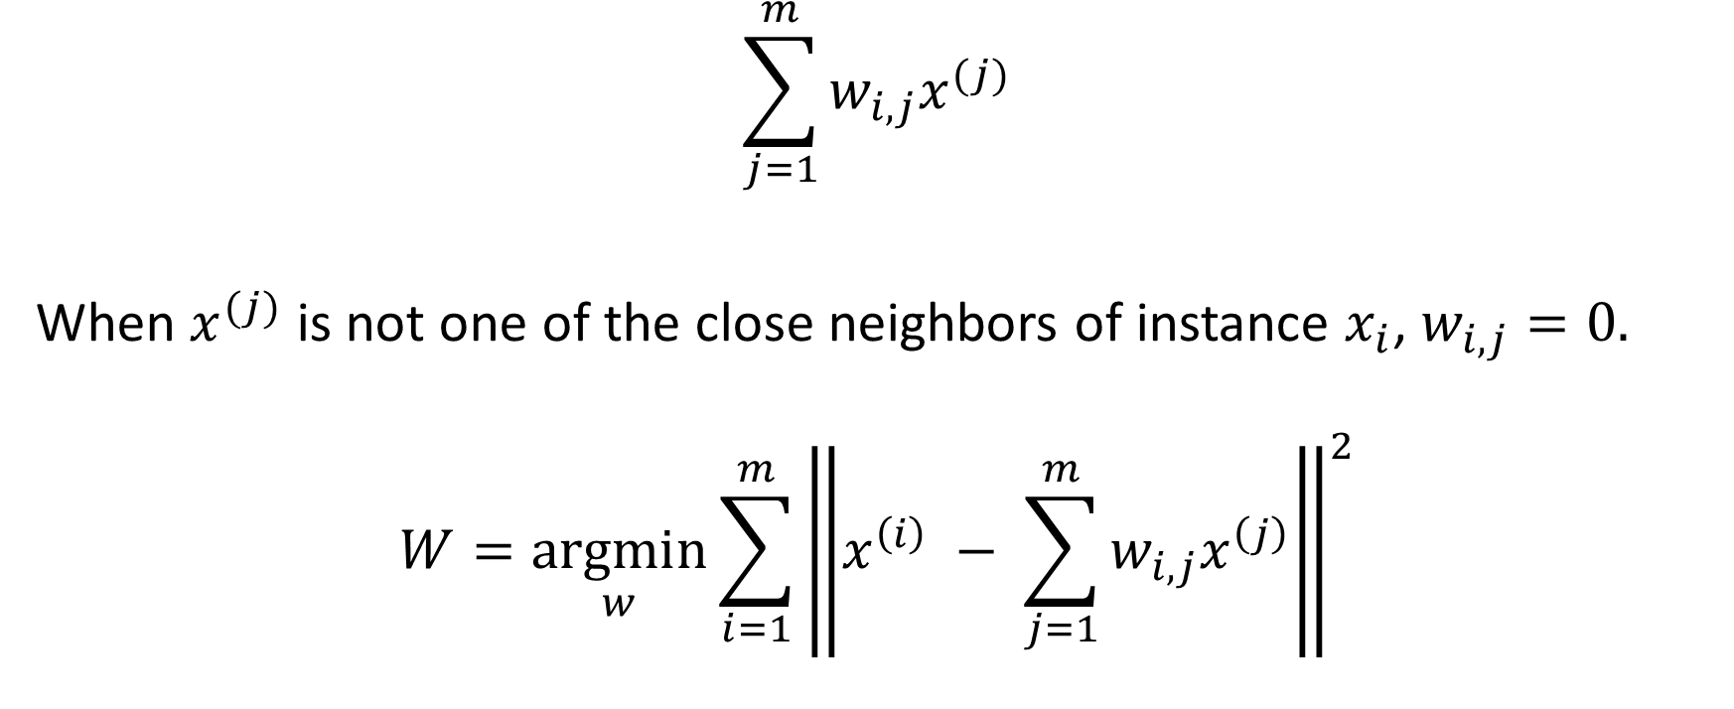
How LLE works:
$$\sum_{j=1}^{m}{w_{i,j}x^{(j)}}$$
When $x^{(j)}$ is not one of the close neighbors of instance $x_{i}$, $w_{i,j}=0.$
$$W={\underset{w}{argmin}{\sum_{i=1}^{m}{\left\|x^{\left(i\right)} − \sum_{j=1}^{m}{w_{i,j}x^{\left(j\right)}}\right\|}}}^{2}$$

Slide 34
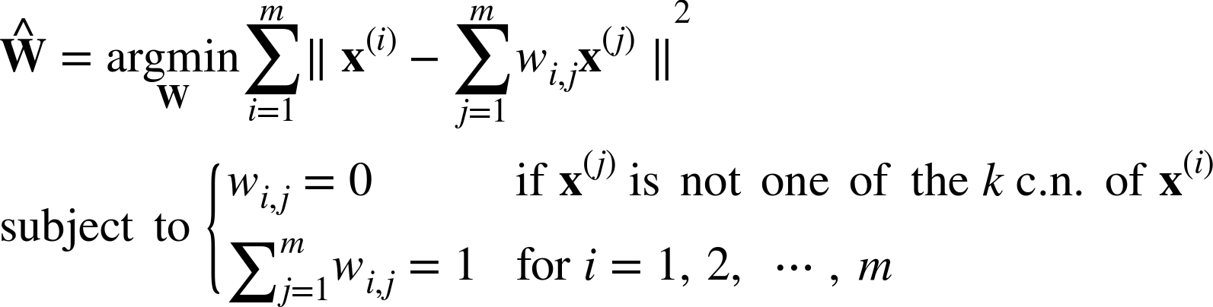
First Step

Slide 35
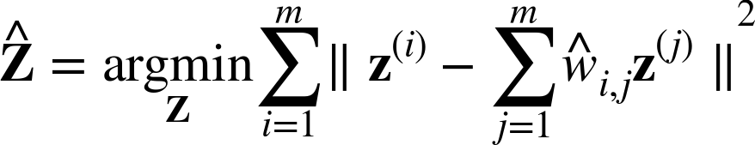

Second Step:
$\hat{Z}$ is the image of X in the lower dimension.

Slide 36
LLE
Time complexity:
O(m log(m)n log(k)) for finding the k nearest neighbors
O(mnk³) for optimizing the weights
O(dm²) for constructing the low-dimensional representations

